Slide 1

The Formula for a
Trending Youtube Video
A PREDICTION TOOL FOR CONTENT CREATORS

Slide 2


Presenters
Team 15
Noopur Latkar
MISM-BIDA 16
Sandeep Vemulapalli
MISM 12

Slide 3
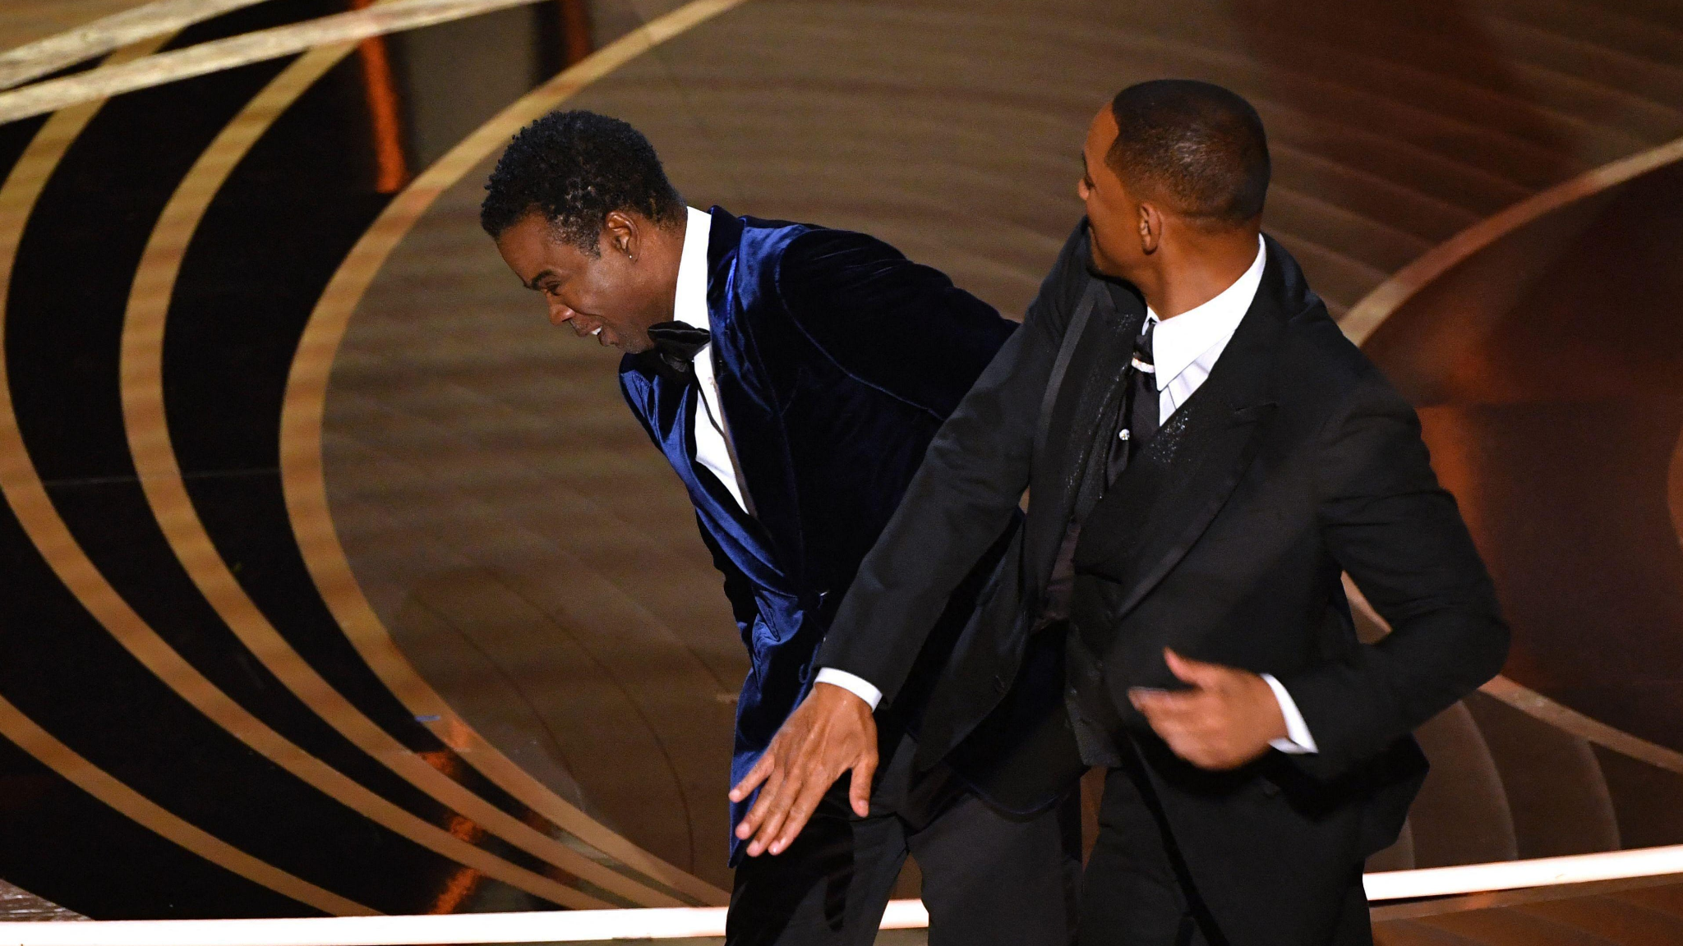
Motivation
Picture courtesy : Google
Reference : Wikipedia
https://en.wikipedia.org/wiki/List_of_most-viewed_YouTube_videos
Notes:
Now we all know what this is. In todays’ day and age, it takes minutes for something to blow up and become wildly popular. After the shocking Will Smith-Chris Rock slapping incident at the Oscars, the both of us discussed on how the video went viral. This piqued our interest in the recent trending videos on popular social media platforms, like Youtube, which is #1.

Slide 4
Motivation
Youtube : world’s #1 video sharing website
100M views in 1 month
48M views in just 16 hours
Significant amount of time and budget
Reach of 10.5 billion (Baby Shark)
Solid content costs $500 - $3000
Picture courtesy : Google
Reference : Wikipedia
https://en.wikipedia.org/wiki/List_of_most-viewed_YouTube_videos
Notes:
This is the exact reason behind choosing trend analysis as our domain for machine learning, the fact that something so trivial reached millions of people across the globe. Imagine something useful and influential reaching such a wide audience and the impact it would have. In addition to the actual content, there are a few knobs that can be tuned to ensure your video goes viral. Say starcast, tags, description, time and date of release, local audience you would want to focus on.

Slide 5
Agenda
Market Strategy for a viral video
Predict the estimated outcome of a video (trending days) before releasing it
Compare alternatives to keep the video trending for more days
Understand the top trending topics across the globe
Capitalize on local audiences depending on the video category

Slide 6
Key Datasets
Youtube Trending List : Kaggle
https://www.kaggle.com/datasets/rsrishav/youtube-trending-video-dataset
United States (US)
India (IN)
Japan (JP)
United Kingdom (GB)
Germany (DE)
6. Canada (CA)
7. France (FR)
8. Russia (RU)
9. Mexico (MX)
10. South Korea (KR)
2. Channel Information : API
https://developers.google.com/youtube/v3

Slide 7
Dataset Features
Real-world data, updated daily
Around 120k observations per country
Total analysis on 1.2 million observations
Global data spread over 10 countries
16 feature columns
Views
Likes
Trending Days
Video Description
Channel Information
number of subscribers
number of videos hosted
Notes:
Channel on which it is published also plays a key role in determining its view count.

Slide 8
Key Findings
Business Case : First-of-its kind tool for content creators
Predicting number of days your video will be trending
Increasing viewership pattern by altering video cast and keywords in description
Creating more visibility and knowing your reach
Targeting a specific audience geographically based on your video genre
Choosing a platform that boosts traction
Notes:
A content creators with our tool at their disposal can boost their viewership and traction . A small tweak

Slide 9
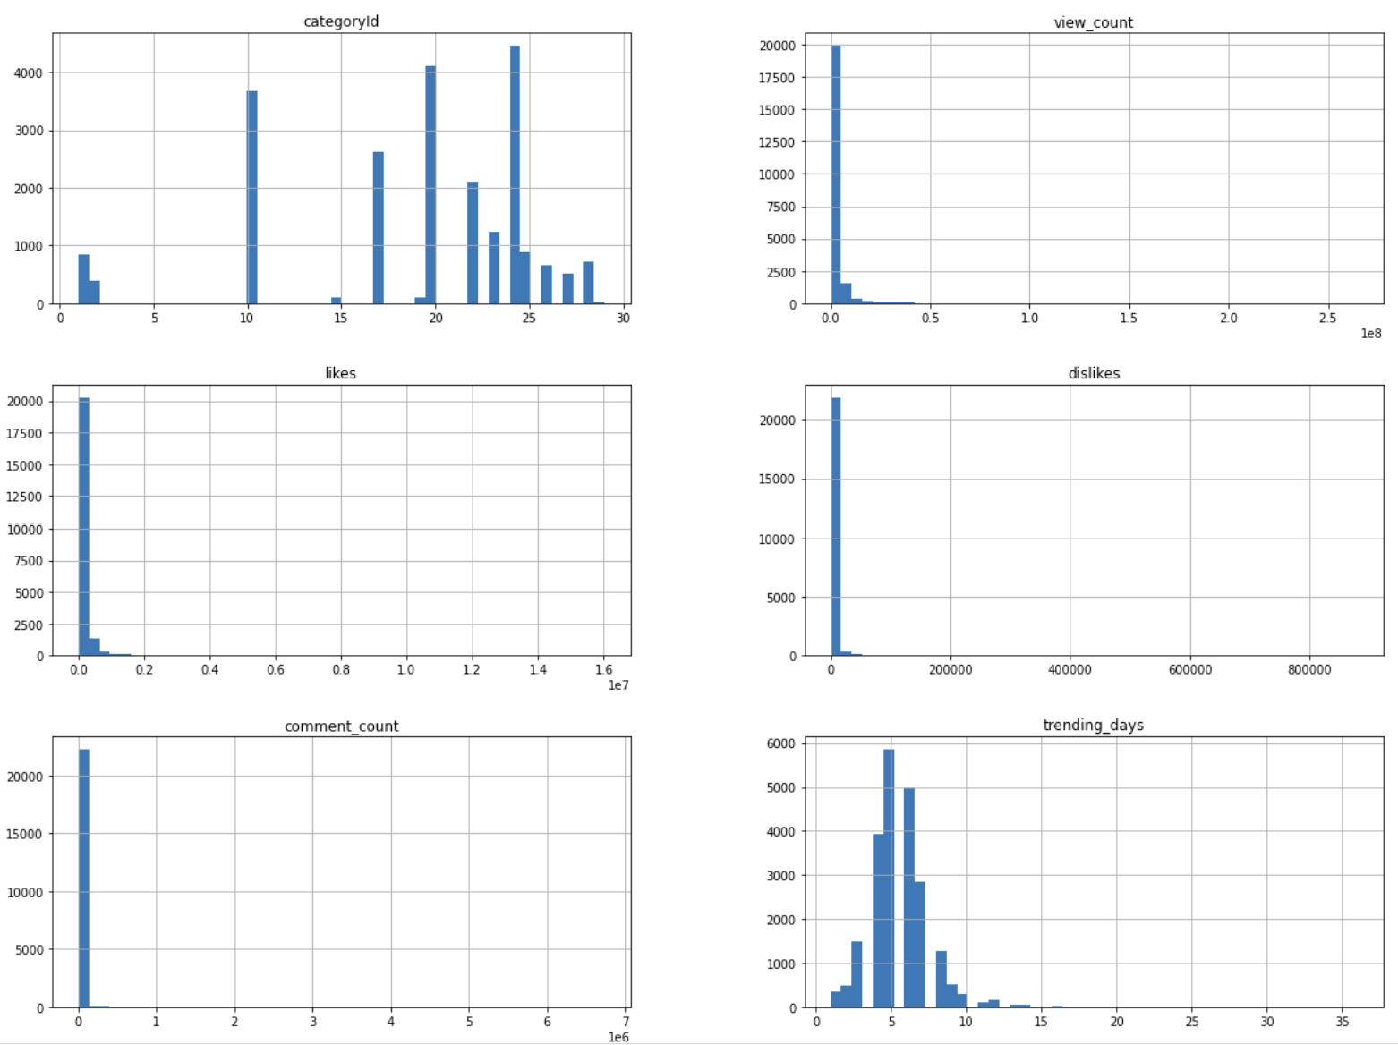
Preliminary Analysis on Data
Notes:
Preliminary data analysis to get an idea of the dataset in hand

Slide 10
Preliminary Analysis on Data
1
2

Slide 11
Preliminary Analysis on Data
1
Majority trending videos fall under category 24 : Entertainment
1
2
Videos generally trend between 1-10 days, rarely beyond that
2

Slide 12
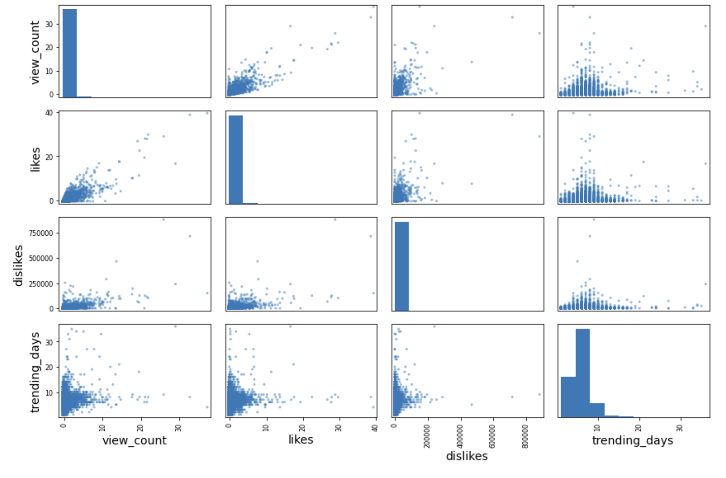
Preliminary Analysis on Data

Slide 13
Preliminary Analysis on Data
1
2
3

Slide 14
Preliminary Analysis on Data
1
2
1
view_count and likes are positively correlated
3
view_count is normally distributed over treding_days
2
3
likes are normally distributed over trending_days
Notes:
Positive upward trend in likes as view count steadily increases

Slide 15
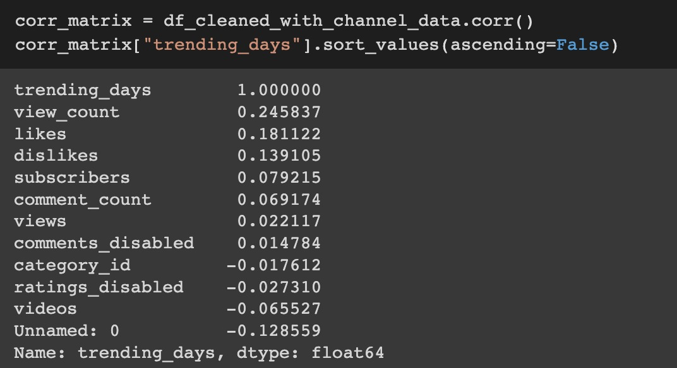
Data Correlation Analysis
Notes:
A content creator with our tools at their disposal can increase their viewership and traction by

Slide 16
Data Correlation Analysis
Target variable : trending_days
Most correlated feature : view_count
Notes:
A content creator with our tools at their disposal can increase their viewership and traction by
(continuous output variable -> regression problem)

Slide 17
Data Preprocessing
Data Cleaning
Dropping rows containing NaN values
Formatting text data in description and tags
Deleting non-English observations
Dropping features that are not useful for prediction
Handling categorical variables (comments_disabled, ratings_disabled)
Notes:
A content creator with our tools at their disposal can increase their viewership and traction by

Slide 18
Performance Measures
Root Mean Squared Error (RMSE)
Mean Absolute Error (MAE)
Mean Absolute Percentage Error (MAPE)
Notes:
A content creator with our tools at their disposal can increase their viewership and traction by

Slide 19
Base Model Error
 | Linear Regressor | Decision Tree Regressor | Random Forest Regressor
RMSE | 2.08 days | 2.91 days | 2.14 days
MAE | 1.43 days | 2.09 days | 1.46 days
MAPE | 34.69% | 45.34% | 33.40%
Lowest error percentage
Notes:
So now we have our comparison parameter ready, and we can feature engineer, play around with data and explore more complex and robust models to give better accuracy.

Slide 20
Merging Datasets
Adding channel information via API
Features per channel :
Number of subscribers
Total number of videos
Views of all videos
Platform information adds value to the learning model quantified by increased accuracy
New features are added to dataset on unique ‘channel_id’
Finding : Trending days usually increase when video is released on a popular channel
Notes:
A content creator with our tools at their disposal can increase their viewership and traction by
Even though view count had a strong correlation with output_variable i.e trending days, it is clear from the error percentage that there exist other influential features outside the dataset. After fetching for this, we realized that

Slide 21
Deploying an MLP Regressor
Architecture
Leaky ReLu
Leaky ReLu
Leaky ReLu
Leaky ReLu
Leaky ReLu
Leaky ReLu
Leaky ReLu
Leaky ReLu
HI
D
D
E
N
-
2
HI
D
D
E
N
-
3
HI
D
D
E
N
-
4
HI
D
D
E
N
-
5
HI
D
D
E
N
-
6
HI
D
D
E
N
-
7
HI
D
D
E
N
-
8
HI
D
D
E
N
-
1
O
U
T
P
U
T
view_count
channel_subscribers
channel_videos
likes
dislikes
comment_count
I
N
P
U
T
6
1
256
64
32
256
128
512
512
512
Notes:
A content creator with our tools at their disposal can increase their viewership and traction by

Slide 22

Performance Improvement
Drop in Error Percentage
33.4%
28.76%
Notes:
A content creator with our tools at their disposal can increase their viewership and traction by

Slide 23
Keyword Extraction using NLP
Co-occurrence analysis
Keywords are extracted from description of video using SpaCy library
Text is tokenized to identify person names featuring in the video
A unique popularity score is computed to account for covariance :
Amongst people co-occurring together
Between people and trending days
Finding : Possibly related entities or popular pairs generate higher popularity
score when co-occurring, increases trending days
Notes:
A content creator with our tools at their disposal can increase their viewership and traction by
Even though view count had a strong correlation with output_variable i.e trending days, it is clear from the error percentage that there exist other influential features outside the dataset. After fetching for this, we realized that

Slide 24
Adding Input Feature to MLP Regressor
Architecture
Leaky ReLu
Leaky ReLu
Leaky ReLu
Leaky ReLu
Leaky ReLu
Leaky ReLu
Leaky ReLu
Leaky ReLu
HI
D
D
E
N
-
2
HI
D
D
E
N
-
3
HI
D
D
E
N
-
4
HI
D
D
E
N
-
5
HI
D
D
E
N
-
6
HI
D
D
E
N
-
7
HI
D
D
E
N
-
8
HI
D
D
E
N
-
1
view_count
channel_subscribers
channel_videos
likes
dislikes
comment_count
popularity_score
O
U
T
P
U
T
I
N
P
U
T
7
1
256
64
32
256
128
512
512
512
Notes:
A content creator with our tools at their disposal can increase their viewership and traction by

Slide 25

Performance Improvement
Drop in Error Percentage
33.4%
28.76%
27.75%
Accuracy : 72.25%
Notes:
A content creator with our tools at their disposal can increase their viewership and traction by

Slide 26
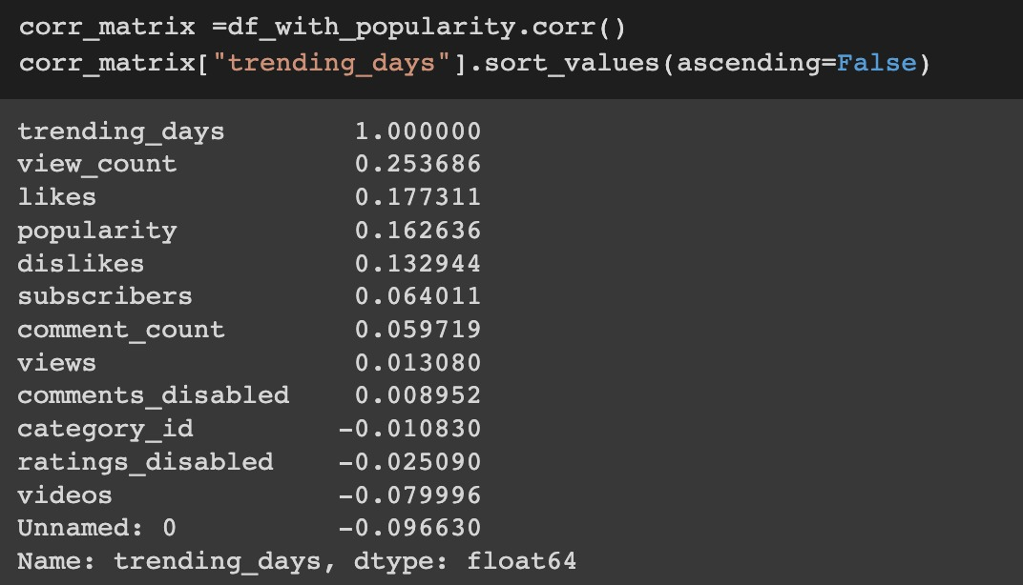
Data Correlation Analysis
‘Popularity’ is now the third most relevant feature contributing to explain trending_days
‘Channel subscribers’ is now the fifth most relevant feature contributing to explain trending_days
Notes:
A content creator with our tools at their disposal can increase their viewership and traction by
(continuous output variable -> regression problem)

Slide 27
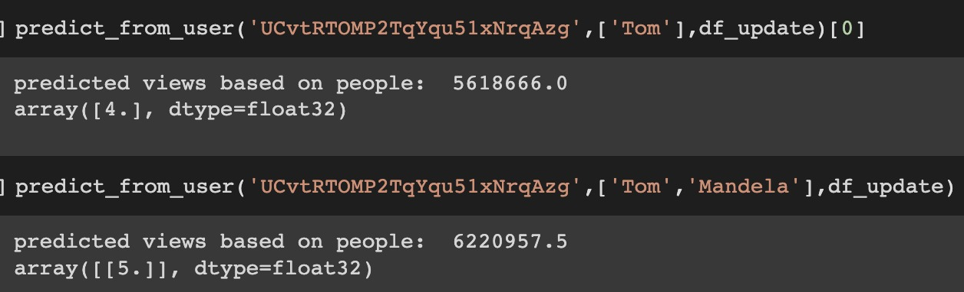
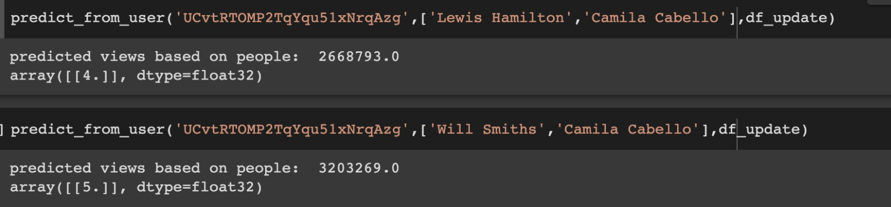
Business Application
Content Creator Use Case
Notes:
A content creator with our tools at their disposal can increase their viewership and traction by

Slide 28
Top Trending Categories across Countries
Entertainment
US
India
Canada
Denmark
Japan
Great Britain
France
Mexico
Korea
Music
India
Canada
People and Blogs : Russia
Sports : Great Britain
Gaming : Japan
Notes:
A content creator with our tools at their disposal can increase their viewership and traction by

Slide 29
Future scope
Thank you!
Utilizing hashtag information from video data to capitalize on young generation trend words
Image Processing on thumbnail icon of every video, to predict which cover photo would garner most views for that video
Group videos with disabled comments and disabled dislikes as scandalous videos and study further for interesting insights

